Slide 1
KHATRA ADIBASI MAHAVIDYALAYA
B.A Program in Physical Education Name of the Teacher- TITHI ROY
Subject- Physical Education
Semester - III
Course Title: Yogasana and Gymnastics
Topic: Unit- I: YOGASANA
Session: 2019-20

Slide 2
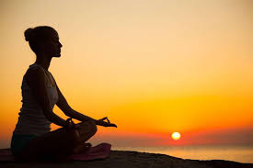
YOGA

Slide 3
Virabhadrasana

Slide 4
Steps of Virabhadrasana

Slide 5
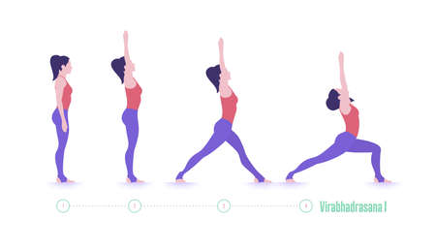
Steps of Virabhadrasana

Slide 6
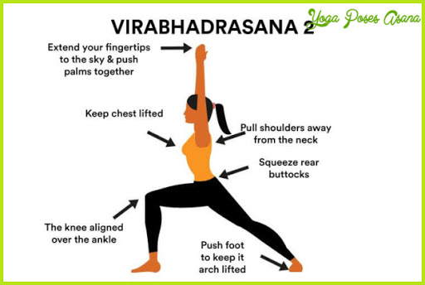
Virabhadrasana

Slide 7
Benefits of Virabhadrasana

Slide 8
Benefits of Virabhadrasana

Slide 9
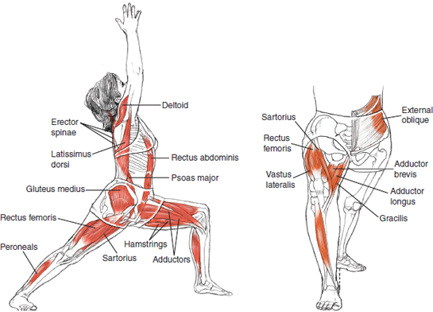
Benefits of Virabhadrasana

Slide 10
THANKS TO ALL

